Slide 1
Cloud Cost Observability
A Terraform Solutions Workshop
at BLDRcon 2025
Presented by Bryan Dady

Slide 2
Cloud Cost Observability:
Terraform Solutions Workshop
This hands-on workshop covers how to create cloud cost anomaly monitoring via Infrastructure-as-Code. We'll look at capabilities provided by AWS, Azure, and GCP, and how to work with them in Terraform.
Welcome ( <= You are here )
Resource Grouping, Tagging
Demo
Q&A
Notes:
Outline:
Requirements
Billing Structures / Resource Grouping and Tagging
Live coding demo (30 minutes)
- AWS Cost Anomaly monitor (10 minutes)
- Azure Cost Anomaly monitor (10 minutes)
- Google Billing Budget (10 minutes)
Q&A

Slide 3
Prerequisites
01
github.com/bcdady/cloud-cost
02
Terraform or OpenTofu CLI installed and working knowledge of how to run it.
03
One or more of AWS, Azure, or GCP account(s) and CLI tool(s) with local authentication.

Slide 4
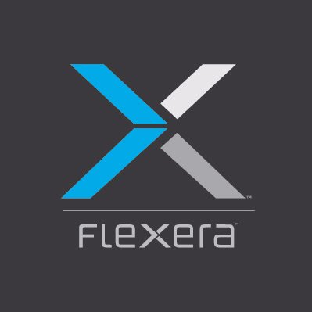
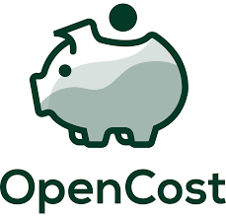



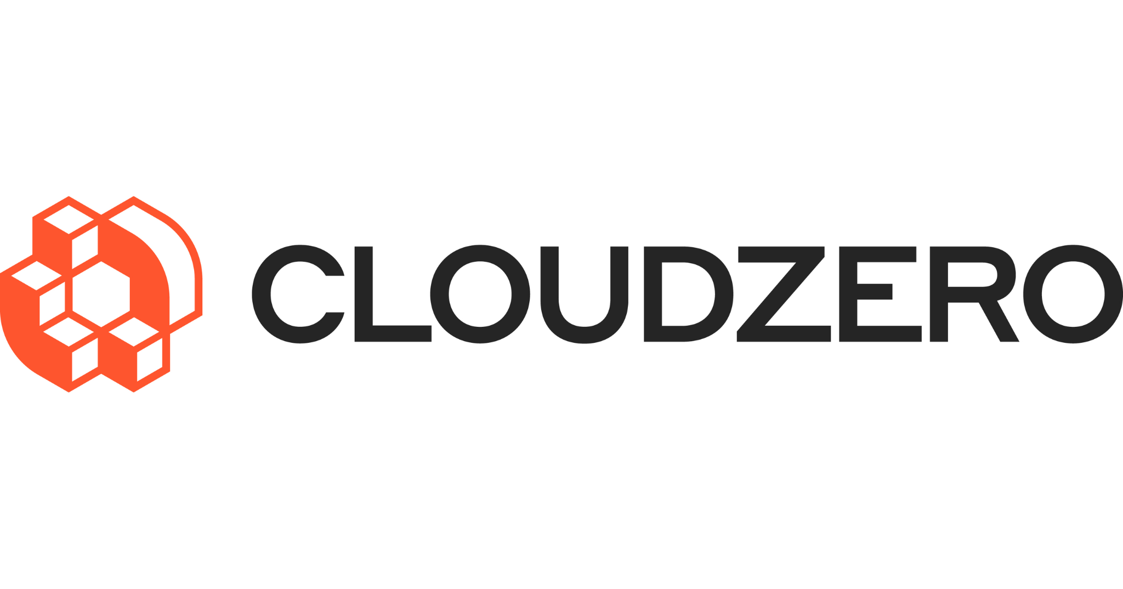
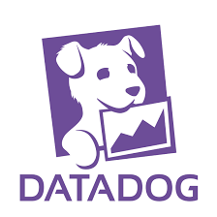
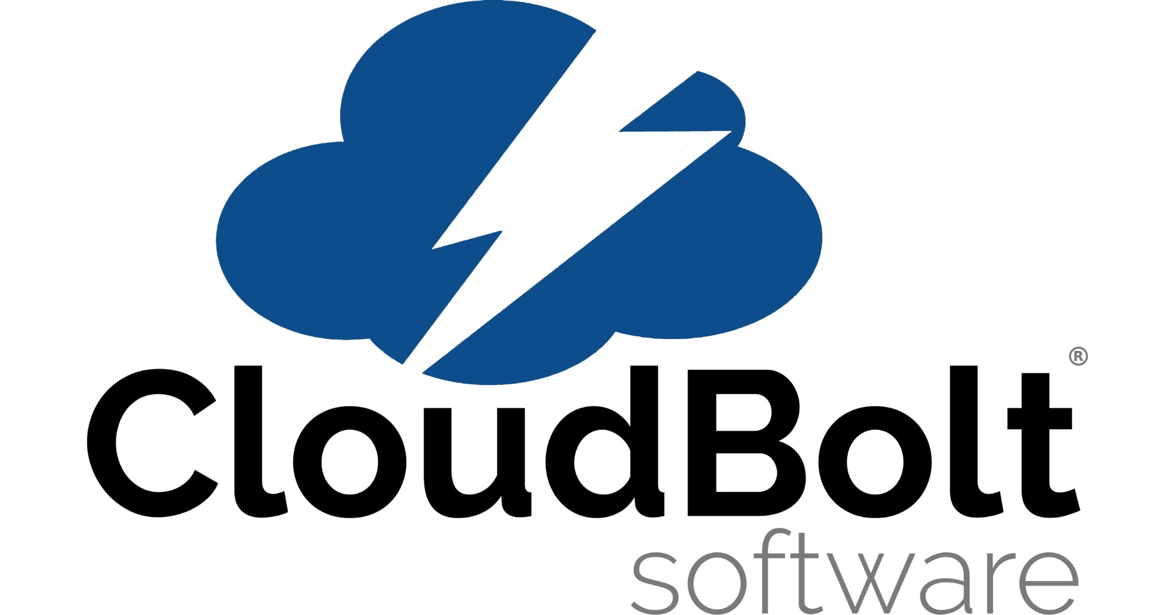
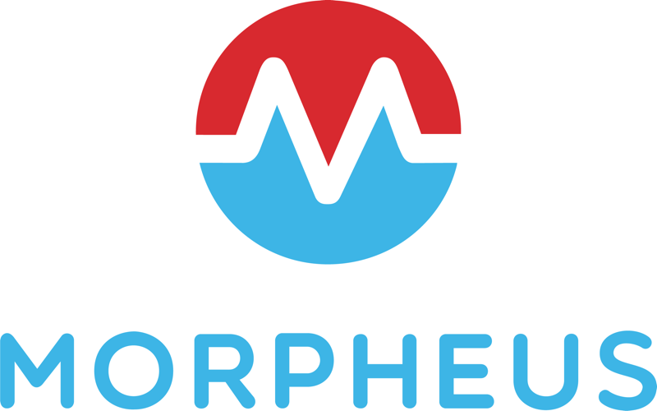
Market Landscape
Notes:
All these tools exist to help you see and manage your cloud costs.
I’ve used several of these tools, and what they don’t do well, at least out of the box, is add context or organize your resources.
You still have to do that yourself.

Slide 5
Billing Structures across CSPs
AWS
Billing Unit: Account
Azure
Billing Unit: Subscription
GCP
Billing Unit: Project
Notes:
The billing structure alignment with resource grouping varies across AWS, Azure, and GCP.
Resource Grouping, Tagging of resources are essential to think through and consider how cost observability will correlate to how resources are deployed from this context
AWS
Billing Unit: Account level 4
Resource Grouping: Flexible approach using Resource Groups
Alignment:
AWS uses a multi-account approach, enabling isolation of resources, including billing and user access2.
Consolidated billing allows for aggregating charges from multiple accounts into a single invoice, simplifying cost management while maintaining separate resource groups4.
Resource Groups can be used for cost allocation, but the primary billing structure is at the account level.
Azure
Billing Unit: Subscription level
Resource Grouping: Hierarchical structure with Management Groups, Subscriptions, and Resource Groups
Alignment:
Subscriptions serve as both billing units and containers for resource groups2.
Management Groups can reflect the billing structure, allowing for a hierarchical organization of subscriptions2.
This model successfully combines user and service management with resource clustering, facilitating easier cost allocation and management2.
Google Cloud Platform (GCP)
Billing Unit: Project level1
Resource Grouping: Hierarchical structure with Organization, Folders, and Projects
Alignment:
Projects are the basic containers for resources and also serve as billing units1.
Cloud Billing accounts are linked to projects, defining which billing account pays for costs incurred by specific projects1.
The resource hierarchy (Organization > Folder > Project) allows for tracking expenses at each level, providing insights into the financial impact of different organizational segments4.
Key Differences and Considerations
Flexibility vs. Structure: AWS offers more flexibility in resource grouping but potentially less structure in billing management. Azure and GCP provide more structured approaches that align closely with organizational hierarchies2.
Cost Allocation: All providers support tagging or labeling resources for cost allocation purposes, but the implementation varies:
AWS: Tags appear in detailed billing reports when enabled3.
Azure: Tags can be applied at various levels of the resource hierarchy.
GCP: Labels can be used for more granular cost tracking within projects.
Multi-Cloud Challenges: Managing costs across multiple cloud providers can be complex due to differences in pricing models, billing structures, and resource organization5. This may require additional tools or services for effective cost management across platforms.
Financial Governance: Each provider offers tools for budget alerts, cost forecasting, and usage monitoring, but the integration with resource grouping varies. Azure and GCP's hierarchical models may provide more intuitive cost management across organizational structures68.
By understanding these differences, organizations can better align their resource grouping strategies with billing structures, enabling more effective cost management and financial governance across cloud platforms.
Citations:
https://cloud.google.com/billing/docs/concepts
https://cloud.theodo.com/en/blog/manage-cloud-project
https://www.finops.org/wg/cloud-cost-allocation/
https://www.billgist.com/blog/unlocking-your-billing-breakdown-a-guide-to-understanding-your-charges-315d/
https://kion.io/resources/organizing-and-managing-multi-cloud-costs-at-scale
https://cloud.google.com/billing/docs/onboarding-checklist
https://learn.microsoft.com/en-us/azure/cloud-adoption-framework/ready/azure-setup-guide/organize-resources
https://learn.microsoft.com/en-us/azure/cloud-adoption-framework/ready/landing-zone/design-area/resource-org-management-groups
Answer from Perplexity: pplx.ai/share

Slide 6
Demonstration
Notes:
Timeline:
Live coding demo (20 minutes)
- AWS Cost Anomaly monitor (10 minutes)
- Azure Cost Anomaly monitor (5 minutes)
- Google Billing Budget (5 minutes)

Slide 7

Bryan Dady
Thank you!!
Bryan is a technology leader based in Missoula, Montana, with over 20 years of experience in cloud infrastructure, site reliability engineering, and team leadership. Having served in IT and technology management roles at IBM, Washington Mutual / JP Morgan Chase, and T-Mobile, he focuses on building and scaling cross-functional teams, optimizing cloud platforms, and implementing DevOps best practices.
bryandady.com
linkedin.com/bryandady

